Slide 1
Lecture 35 Dec. 9th , 2019
Exam 3 returned
GFP paper--
Great job in lab!
Exam 4 next Friday—Dec. 13th. I have decided to incorporate exam 4 material into the final exam. ~30% new material/~70% cumulative
Final exam Thursday, Dec. 19th, 8-10 am. No non-emergency rearrangements please.

Slide 2
Where were we?
Telomeres! What the heck are they?
DNA sequences, added in tandem, to the ends of linear chromosomes, by an enzyme, telomerase.
Human telomere sequence is: 5’ T T A/G G G G 3’
All vertebrates have similar telomere repeat sequences that are G-rich.

Slide 3
After each round of replication, the lagging strand has an unfilled gap, where primers are removed, but if no adjacent Okasaki fragment exists, the gap cannot be filled.
Since this strand serves as template in the next round of replication there is potential for continued shortening of each linear chromosome.

Slide 4
Telomerase is an interesting enzyme which uses its own built in template to copy short repeats which are added to the ends of the inherited DNA. Telomeres are just repeats of this DNA sequence.
The template is actually RNA!

Slide 5
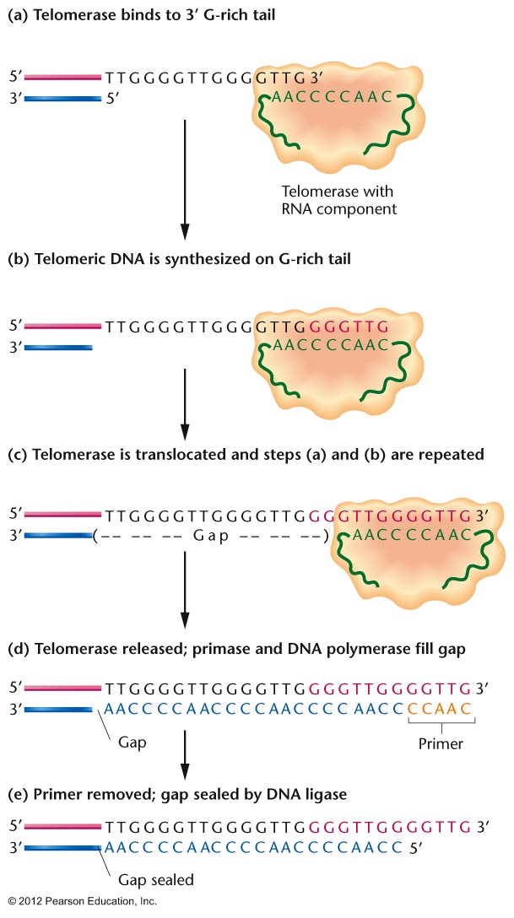
Notes:
Figure 11.17

Slide 6
Telomeres are interesting and sometimes misunderstood.
In early development our telomerase is active and continually making telomeres to protect chromosome ends during times of rapid cell division (because DNA replicates prior to every cell division).
Long telomeres are actually as sign of youth--and sham pharmaceuticals are available to “lengthen your telomeres”

Slide 7
YIKES
https://primalforce.net/vsl/thrive-page-for-telo-x-nano/?as_campaign=ppc_google_teloxnano_thrive_presale_20191127&as_source=google&as_medium=ppc

Slide 8
But in fact, the shortening of telomeres IS protective. Since telomerase stops making telomeres after early development, each time a cell divides its telomeres shorten.
Shortening is an indicator that a cell has divided many times, and the DNA that cell is “old” having been replicated many times.
That DNA is likely to have accumulated mutations

Slide 9
Cells “monitor” length of their telomeres and are programed to undergo apoptosis (programed cell death) when chromosomes shorten to a critical length).
This takes cells which would likely have lots of mutations out of the organism. Cancer is the result of lots of mutations in a cell--

Slide 10
Critical thinking…
Analysis of cancer cells sometimes shows that they have abnormally active telomerase.
Try to explain why this might not be surprising.

Slide 11
Moving on from DNA and DNA replication…
Gene expression—decoding the DNA
Jumping to Chapter 13, which considers DNA as the genetic material, the code for development and activities of living things.
Historically, we assumed the proteins encoded by DNA were the essential control molecules of cells.

Slide 12
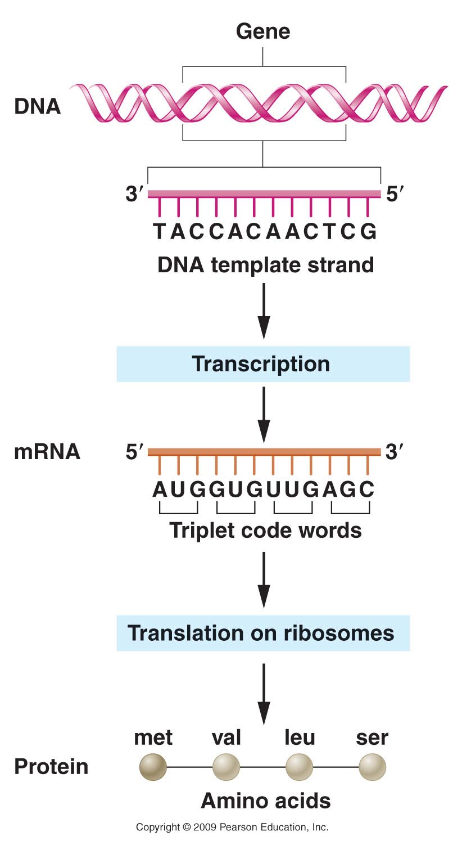
trait/phenotype
Figure 14.1
Notes:
12
Figure 14-1 Flow of genetic information encoded in DNA to messenger RNA to protein.

Slide 13
Tall and short plants are assumed to be the result of different versions/amounts of the same protein.
trait/phenotype
Figure 14.1
Notes:
13
Figure 14-1 Flow of genetic information encoded in DNA to messenger RNA to protein.

Slide 14
Prokaryotes’ chromosomes are nearly all protein coding sequence for the proteins they make. Little inter-gene sequence and proteins are encoded continuously (with no introns).
Many eukaryotic organisms, including humans have much more DNA than is needed for the proteins they make. (Lots of intergene sequence and genes are interupted with introns).
E.g. humans make about 25,000 proteins. The protein encoding genes include only about 2% of the DNA in our 23 pairs of chromosomes.

Slide 15
A genetic puzzle…
Why do eukaryotic organisms contain so much non-protein coding DNA?

Slide 16
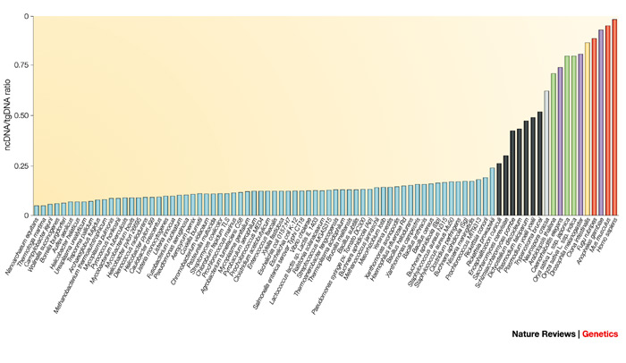
humans
>98% non-coding
Amount of non-protein-coding DNA
eukaryotes
Bacteria

Slide 17
One reason? RNA is probably more important than anyone predicted!!
Shift to studying RNA itself as an (equally?) important regulatory molecule.
Much of the “non-coding” DNA encodes RNA which functions as RNA, without being translated to protein.
e.g. ---a class of RNAs called microRNAs.

Slide 18
Chapter 13…
We will still focus on the “original” central dogma of genetics.
-The classical view
of the flow of genetic
information from DNA
to protein.

Slide 19
Gene expression begins with transcription of DNA into RNA.
Mechanism has many similarities to replication.
A polymerase enzyme copies a DNA template (single strand)
New strand of RNA is complementary to the DNA sequence.

Slide 20
DNA (portion of a gene)
3’----G-C-A-A-T-C-T-A----5’…
5’----C-G-T-T-A-G-A-T---3’…

Slide 21
coding strand
DNA
3’----G-C-A-A-T-C-T-A----5’…
5’----C-G-T-T-A-G-A-T---3’…

Slide 22
coding strand
Non-coding strand
DNA
3’----G-C-A-A-T-C-T-A----5’…
5’----C-G-U-U-A-G-A-U---3’…
(complementary RNA)
5’----C-G-T-T-A-G-A-T---3’…

Slide 23
Several key differences
Only specific regions of the DNA are transcribed into RNA (Genes)
--90+% of bacteria genome is genes
--<2% of human genome is genes (as traditionally defined)
2. Within genes only one of the 2 strands is transcribed (coding strand)

Slide 24
Newly made RNA dissociates from the DNA template. (not like semi-conservative replication)
Enzyme is RNA polymerase.

Slide 25
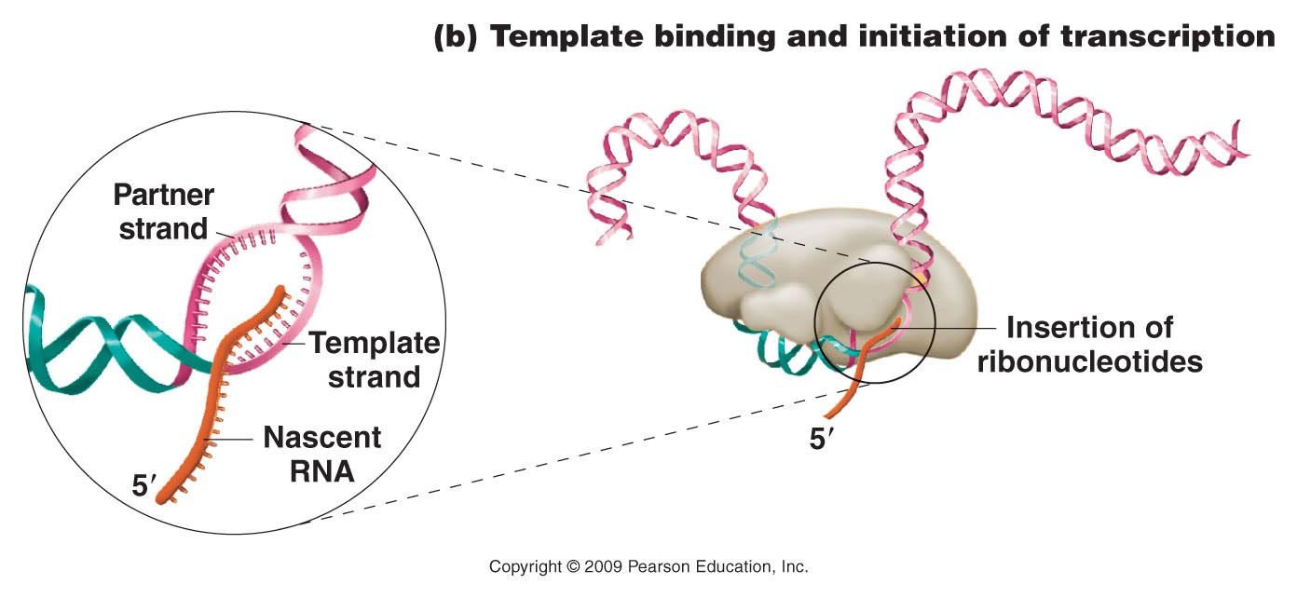
RNA polymerase

Slide 26
humans
>98% non-coding
Amount of non-protein-coding DNA
eukaryotes
Bacteria

Slide 27
RNA is probably more important than anyone predicted!!
Shift to studying RNA itself as an (equally?) important regulatory molecule.
Much of the “non-coding” DNA encodes RNA which functions as RNA, without being translated to protein.
e.g. ---a class of RNAs called microRNAs.

Slide 28
Chapter 13…
We will still focus on the “original” central dogma of genetics.
-The classical view
of the flow of genetic
information from DNA
to protein.

Slide 29
Gene expression begins with transcription of DNA into RNA.
Mechanism has many similarities to replication.
A polymerase enzyme copies a DNA template (single strand)
New strand of RNA is complementary to the DNA sequence.

Slide 30
DNA (portion of a gene)
3’----G-C-A-A-T-C-T-A----5’…
5’----C-G-T-T-A-G-A-T---3’…

Slide 31
coding strand
DNA
3’----G-C-A-A-T-C-T-A----5’…
5’----C-G-T-T-A-G-A-T---3’…

Slide 32
coding strand
Non-coding strand
DNA
3’----G-C-A-A-T-C-T-A----5’…
5’----C-G-U-U-A-G-A-U---3’…
(complementary RNA)
5’----C-G-T-T-A-G-A-T---3’…

Slide 33
Several key differences
Only specific regions of the DNA are transcribed into RNA (Genes)
--90+% of bacteria genome is genes
--<2% of human genome is genes (as traditionally defined)
2. Within genes only one of the 2 strands is transcribed (coding strand)

Slide 34
Newly made RNA dissociates from the DNA template. (not like semi-conservative replication)
Enzyme is RNA polymerase.

Slide 35
RNA polymerase

Slide 36
Transcription varies greatly among different cells.
Different cell types express unique subsets of genes
Changes in environment of cells (stressors, changes in nutrients etc.), trigger changes in expression programs. A different subset of genes may be transcribed in the same cell.
Different stages in development call for different subsets of genes to be transcribed.

Slide 37
General structure of a gene.
Regulatory sequences—eg. the PROMOTER
Protein-coding sequences
Transcription actually starts here
Usually “upstream” from the start site for transcription

Slide 38
Regulatory sequences bind to key proteins involved in transcription.
The promoter binds RNA polymerase itself.

Slide 39
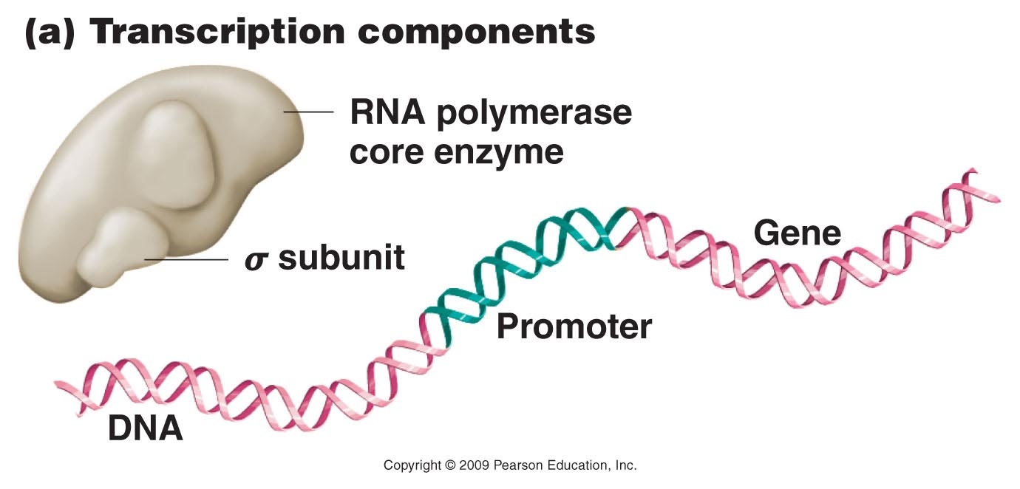
(E. coli)
Important for binding the promoter---initiation of transcription
Figure 14.9a
Notes:
Figure 14-9a The early stages of transcription in prokaryotes, showing (a) the components of the process; (b) template binding at the –10 site involving the sigma subunit of RNA polymerase and subsequent initiation of RNA synthesis; and (c) chain elongation, after the sigma subunit has dissociated from the transcription complex and the enzyme moves along the DNA template.

Slide 40
Figure 14.9b
Notes:
40
Figure 14-9b The early stages of transcription in prokaryotes, showing (a) the components of the process; (b) template binding at the –10 site involving the sigma subunit of RNA polymerase and subsequent initiation of RNA synthesis; and (c) chain elongation, after the sigma subunit has dissociated from the transcription complex and the enzyme moves along the DNA template.

Slide 41
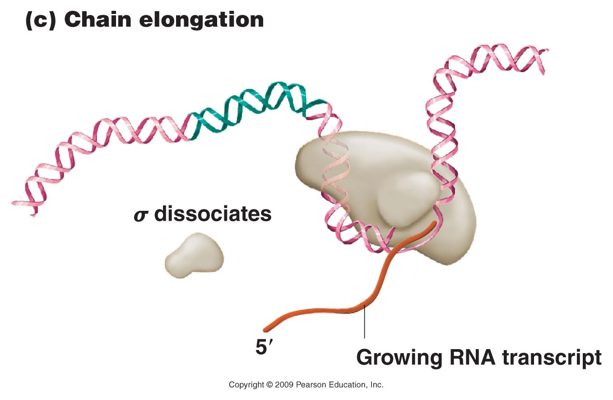
Not needed once transcription is initiated
Figure 14.9c
Notes:
41
Figure 14-9c The early stages of transcription in prokaryotes, showing (a) the components of the process; (b) template binding at the –10 site involving the sigma subunit of RNA polymerase and subsequent initiation of RNA synthesis; and (c) chain elongation, after the sigma subunit has dissociated from the transcription complex and the enzyme moves along the DNA template.

Slide 42
Product is mRNA
In prokaryotes, few if any modifications are made to the mRNA.
In fact, translation begins before transcription is complete

Slide 43
Eukaryotes…
Eukaryotic mRNA
Undergoes many modifications prior to translation
Modifications at both 5’ and 3’ end
Removal of non-coding sequences (introns) that interrupt the coding sequence (exons)

Slide 44
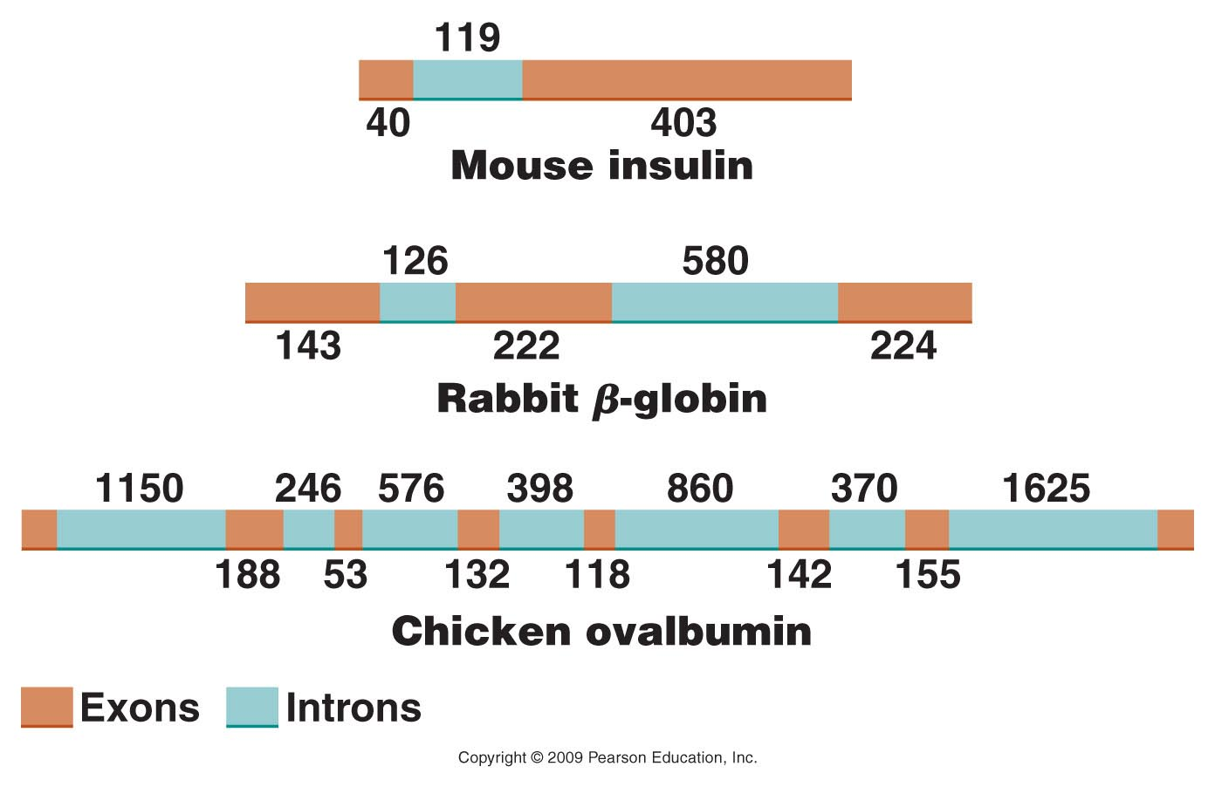
Figure 14.12
Notes:
Figure 14-12 Intervening sequences in various eukaryotic genes. The numbers indicate the number of nucleotides present in various intron and exon regions.

Slide 45
Pre-mRNA =1295 nucleotides
Before translation can begin, introns are removed and exons are spliced together
Mature mRNA =589 nucleotides

Slide 46
Recall the mRNA is modified at both ends
5’----
----3’
5’ Methyl-Guanosine “cap”
3’ polyAdenosine “tail”

Slide 47
Recall the mRNA is modified at both ends
5MeG’----
AAAAAAAAAAAAAAAA₍₁₀₀₋₂₀₀₎---3’
Assumed that the modifications of the mRNA aid its export from the nucleus and mark the RNA as ready for translation.

